Slide 1
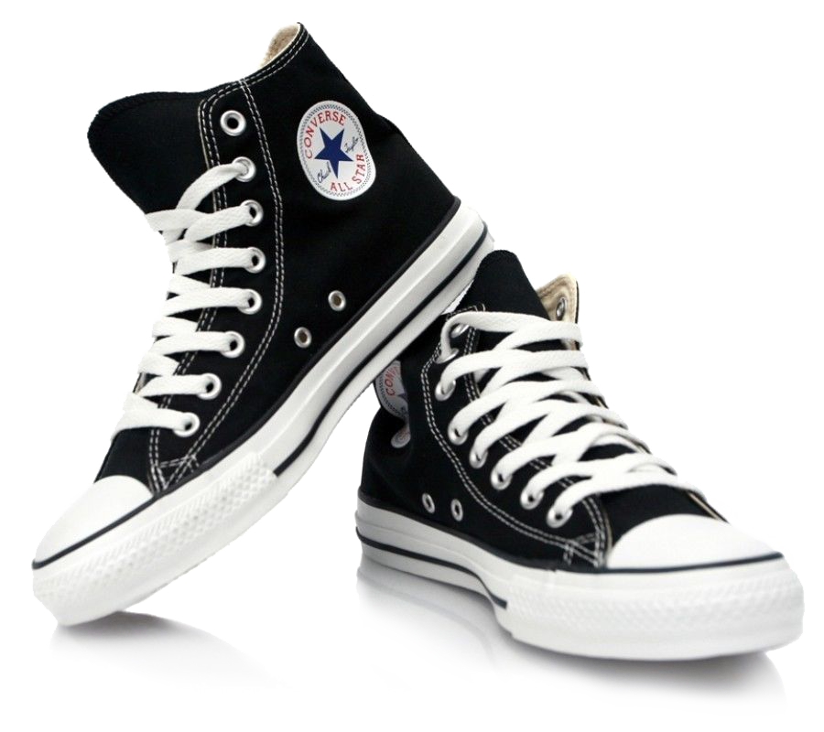

SEPATU
25
%OFF
DISCOUNT
CONVERSE
CONVERSE
CONVERSE
ORDER NOW
+6263478925490

Slide 2

25
SEPATU
%OFF
DISCOUNT
CONVERSE
CONVERSE
CONVERSE
ORDER NOW
+6263478925490

Slide 3

SEPATU
25
%OFF
DISCOUNT
CONVERSE
CONVERSE
CONVERSE
ORDER NOW
+6263478925490

